Slide 1
Data-driven engineering of CRISPR-Cas12a for PAM recognition
Apoorv Saraogee
10/13/2020

Slide 2
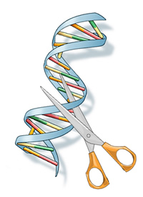
CRISPR in biotechnology
Biodiagnostics
Biomedical research
Medical therapies
DNA
CRISPR Molecular ’scissors’
Notes:
So why talk about CRISPR? CRISPR has emerged as a versatile workhorse across biotechnology
Can think of crispr as a pair of molecular scissors – manipulate specific nucleotide sequences
It has given rise to several useful molecular functions in
Biodiagnostics – detecting nucleotide seqs for infectious diseases
Biomedical research – building model cells, tissues, organisms
Medical therapies – diseases involving genetic mutations such as sickle cell anemia

Slide 3
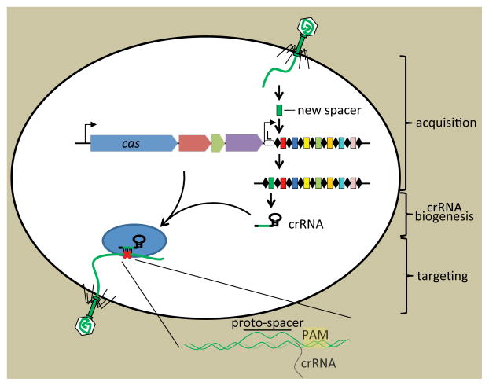
Clustered Regularly Interspaced Short Palindromic Repeats (CRISPR)
Adaptive immunity against viruses in bacteria
CRISPR associated proteins: Cas9/Cas12a
RNA guided endonuclease
PAM – proto-spacer adjacent motif
Targeting mechanism is modified for engineering applications
gRNA
gRNA
gRNA
Barrangou et al. Mol Cell. 54 (2014), 234-244
Notes:
So what exactly is CRISPR? Where does it come from? CRISPR stands for -
It’s a locus of nucleotide Repeats found in prokaryotic genomes. Found to form part of an adaptive immune system against viruses in bacteria or archaea
Prokaryotes acquire a piece of genetic material from an invading phage and store it as a ‘spacer’ between these repeats on their own genomes.
These spacers are used as a memory to fight future infections from the virus.
The spacers are processed into gRNA and used as pointers to the virus in subsequent infections.
Bacteria have evolved highly complex proteins in these systems that are known as Crispr associated proteins or Cas proteins.
Cas9/Cas12a, which are RNA guided endonucleases, were identified as effector proteins. Cas inactivates the virus by using the gRNA to bind to the ‘Proto’-spacer and Proto-spacer adjacent motif or PAM on the virus genome.
The PAM sequence requirement prevents self-targeting because the protospacer or spacer sequence is stored on the bacterium’s own genome
This targeting mechanism is modified for engineering applications in biotechnology.
Although better elucidated, Cas9 requires accessory proteins to process the CRISPR locus. Cas12a has the ability to process its own gRNAs can be used for multiplexed applications to target many sites with a single transcript.

Slide 4
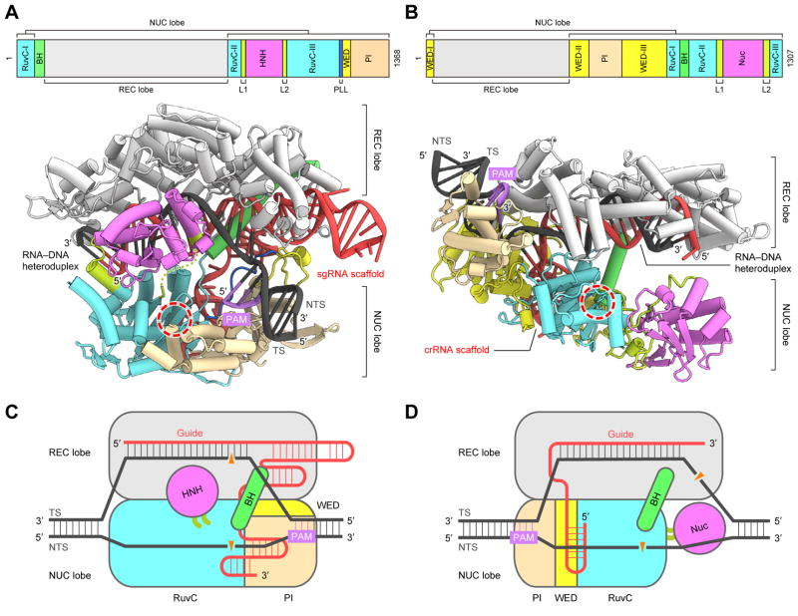
Cas9 vs Cas12a
Cas9
Makes blunt DSBs 3 bases upstream of G-rich PAM
May disrupt PAM site during editing
Cas12a
Makes staggered DSBs 18 and 23 bases downstream of T-rich PAM
Fewer off target effects and higher target specificity
Ability to process own gRNAs
Yamano et al. Cell 165 (2016), 949-962
Notes:
Although cas9 was identified first, we focus on Cas12a as it can process its own gRNAs whereas Cas9 requires other cas proteins

Slide 5
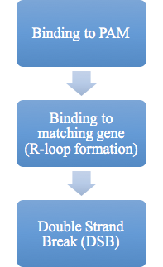
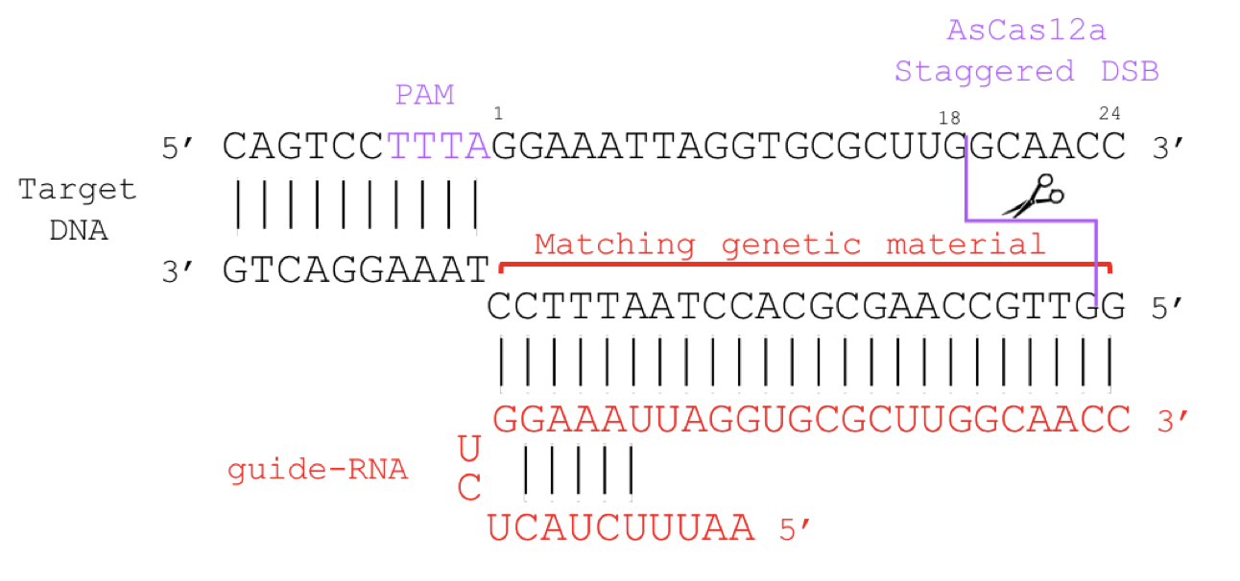
Cas12a function
Notes:
So how does Cas12a function on a molecular level?
Here, you have your target DNA in black where the PAM sequence is shown in purple. The guide-RNA is shown in red and binds to the DNA forming an R-loop
For Cas12a, the PAM sequence is thymidine rich or T-rich and preceding the proto-spacer. Cas12a binds to the PAM site; the guide RNA and DNA hybridize to form on R-loop structure. (three stranded nucleic acid with RNA: DNA)
The protein then undergoes structural conformations to perform a cleavage reaction and double strand break in target DNA.

Slide 6
Cas12a function
Engineering goal:
Develop protein engineering platform for Cas12a-PAM interaction
Notes:
The T-rich PAM site here is highly conserved among homologs in the Cas12a family. Millions of years of evolution have made it difficult to alter these PAM sequences
To target a DNA site, Cas requires presence of the PAM as well as the matching gene for your gRNA. If we can alter the PAM sequences on the target DNA, Cas12a would become more useful and a more versatile protein for engineering applications. You would be able to target many more DNA sites with altered PAMs
Our engineering goal is to learn to alter these PAM sequences for Cas12a and develop a protein engineering strategy for Cas12a-PAM binding function.

Slide 7
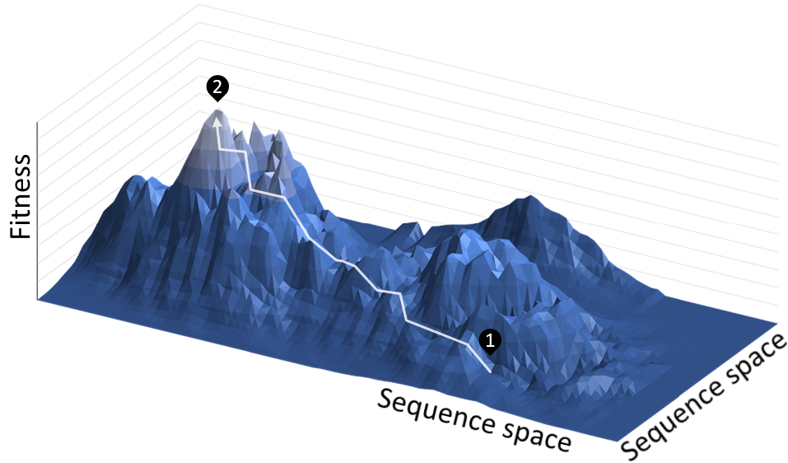
Protein engineering
Traditional approaches of rational design and directed evolution are slow
Data-driven strategy to accelerate exploration of fitness landscape
High-throughput screen
Long-read sequencing and high-throughput computing
Statistical analysis
Notes:
Fitness landscapes are drawn by assigning each sequence and network of neighbours a fitness score.
A representation is shown to the right where each sequence is represented on the x-y plane and the corresponding fitness score is plotted on the z-axis.
Directed evolution is like a random walk in sequence space from a protein with low fitness to maximums or peaks. Many mutational steps may need to be taken to reach a global maximum, making these methods slower
We hope to accelerate the exploration of this fitness landscape using a data-driven approach. We use a high throughput screening method, employ long read sequencing and high throughput computing plus perform statistical analysis

Slide 8
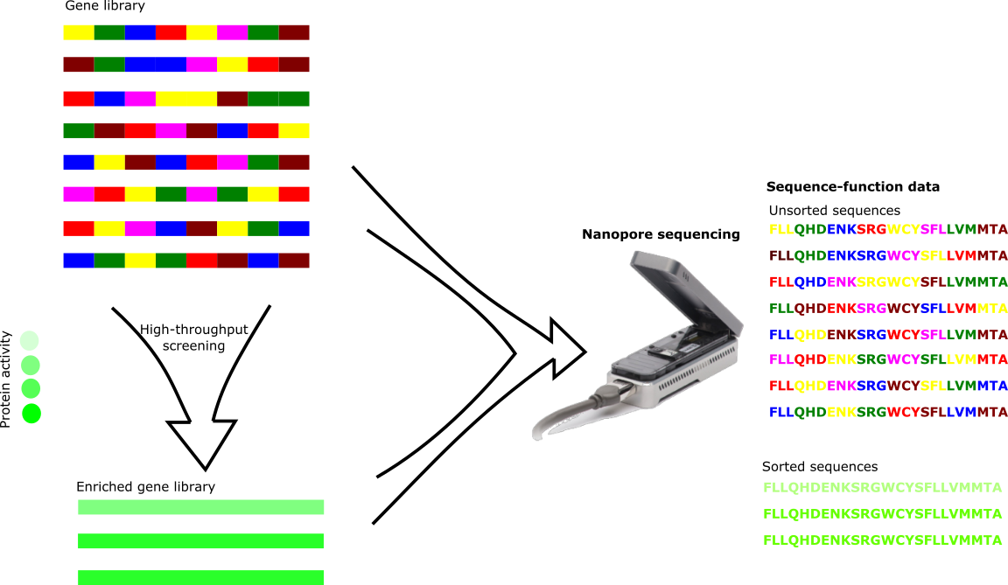
Strategy and aims
2
4
1
Assay for Cas12a function
2
Chimeric gene library design
3
Sequence-function mapping
1
3
4
Statistical analysis (blocks)
Notes:
Our protein engineering strategy has four components that will form the research aims for the project.
1, Development of a high throughput assay for Cas12a function
2, Design of a Cas12a gene library. We are designing a chimeric gene library. Other libraries could be used here such as random mutation libraries
3, Sequence-function mapping using a high throughput screen and next generation sequencing. We use FACS for the high-throughput screen and long-read or nanopore sequencing.
4, Statistical analysis using sequence-function data with unsorted and sorted sequences. Enrichment scores of various sites can be used to learn design principles of Cas12a
We show that our approach can be used to engineer Cas12a with altered PAM specificities. Our developed assay’s level of sequencing throughput (10^6) and sequence diversity (10^6) is what makes our strategy data-driven.

Slide 9
Aim 1: Development of high-throughput assay
Leenay et al. Mol Cell. 62 (2016), 137-147
Notes:
cas12a binds to the PAM site. Explain assay link to GFP production
Right side, explain three plasmid system with library and Beisel lab for proof of concept

Slide 10
Aim 1: Development of high-throughput assay
FITC-A
Notes:
Explain results with assay look good on flow cytometer
Can be expanded to FACS

Slide 11
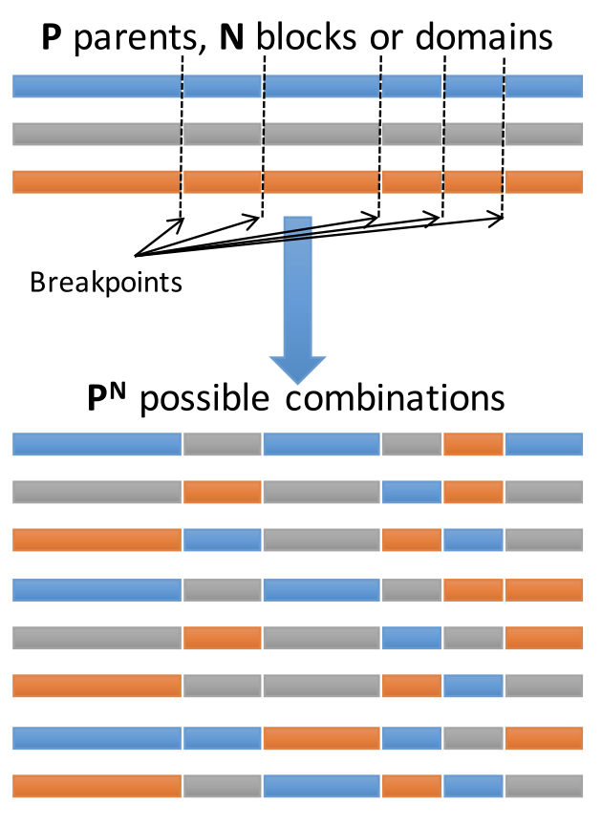
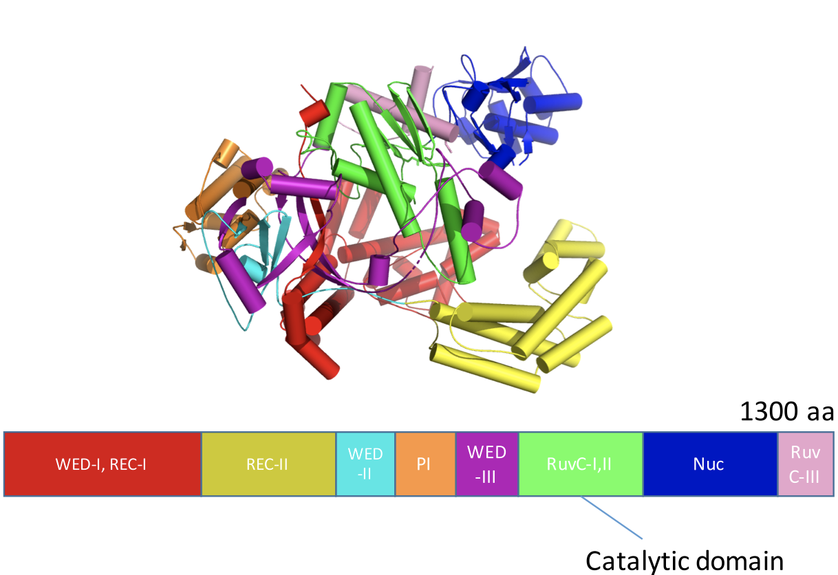
Aim 2: Chimeric Cas12a library design and construction
AsCas12a
REC lobe
NUC lobe
RuvC domain
Yamano et al. Cell 165 (2016), 949-962
Notes:
two major lobes to the protein, one interacts with the gRNA:DNA duplex called the REC lobe and the other interacts with the DNA called the NUC lobe
Why chimeragenesis - large library with high fraction functional.Structural domains form convenient breakpoints.
Mutations are more conservative than random mutagenesis

Slide 12
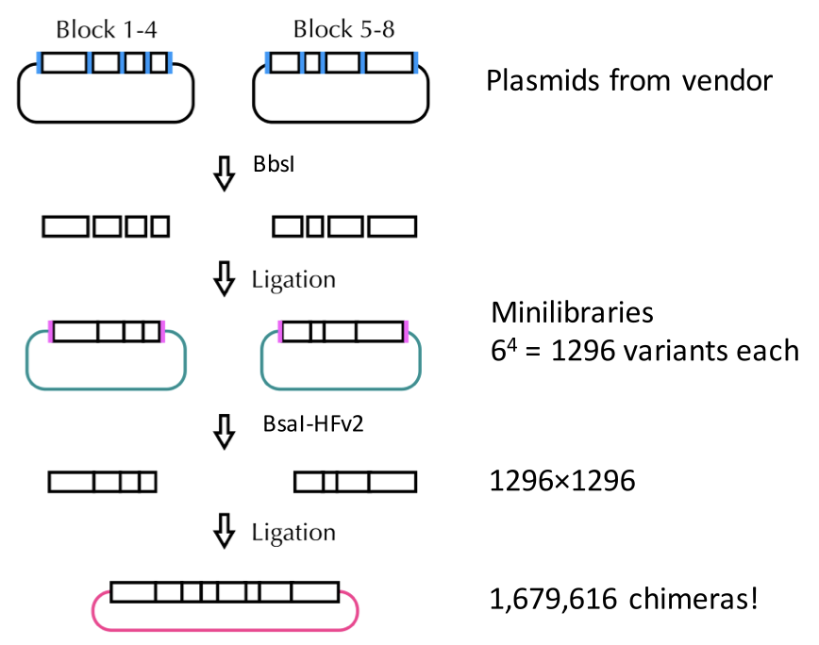
Aim 2: Chimeric Cas12a library design and construction
Golden Gate cloning with Type IIS restriction enzymes (BbsI, BsaI)
6 protein homologs, 8 ‘blocks’
Transformation into E. coli:
3,500,000 transformants (checked by colony forming units)
Notes:
Explain golden gate assembly on the left and theoretical library size
Mention type 11s restriction

Slide 13
Aim 2: Chimeric Cas12a library design and construction
Function test:
~3% functional by colony count
Notes:
Function test, close to 50,000 active mutants

Slide 14
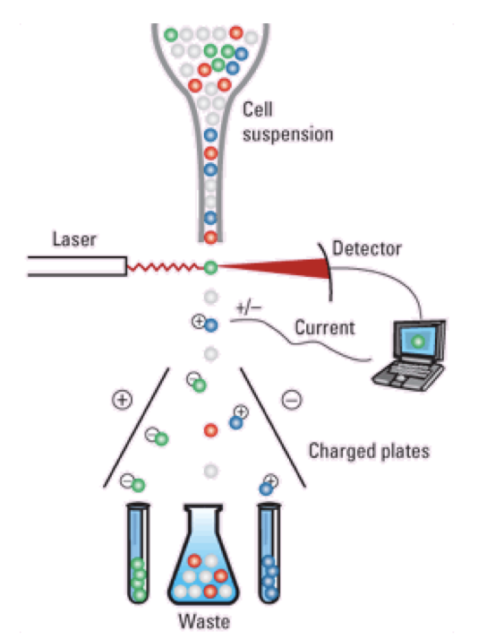
Aim 3: Sequence-function mapping
*
FACS (or microfluidics)
*
Notes:
Picture of FACS and MinION - Sequence function mapping similar to DMS where high throughput screen is coupled with next generation sequencing
FACS provides high quality sorting using commercial equipment. We see that long-read sequencing or nanopore sequencing can identify millions of variants using a computational pipeline to identify chimeric sequences. MinION nanopore sequencing provides high sequencing throughput for larger proteins such as Cas12a with >90% sorting efficiency at 10kHz.
FACS charged plates: In a FACS instrument, fluorescent parameters of cells can be analyzed by a focused laser beam at high rates of 10⁷/hour [9]. A charge is applied to the cells, which are deflected into a collection tube by a charged plate. Cells are collected and sent for sequencing.
Minion explain device - monitor changes in electrical current as nucleic acids pass through a protein nanopore
The sorting experiments are as follows

Slide 15
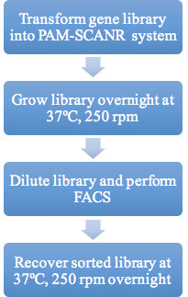
Aim 3: Sequence-function mapping
 | Sort replicate 1 | Sort replicate 2 | Sort replicate 3
Sorted cells | 19,178 | 19,725 | 18,208
Total events | 16,156,994 | 15,527,086 | 15,715,748
Time to sort (min:s) | 23:15 | 25:02 | 22:20
Function after sort | 88% | 91% | 91%
Notes:
Sorting experiment workflow with transforming cells, overnight etc. and then walk through statistics
Screens look good, move on to sequencing with minion

Slide 16
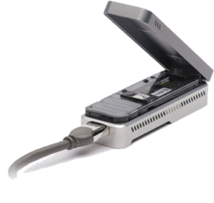
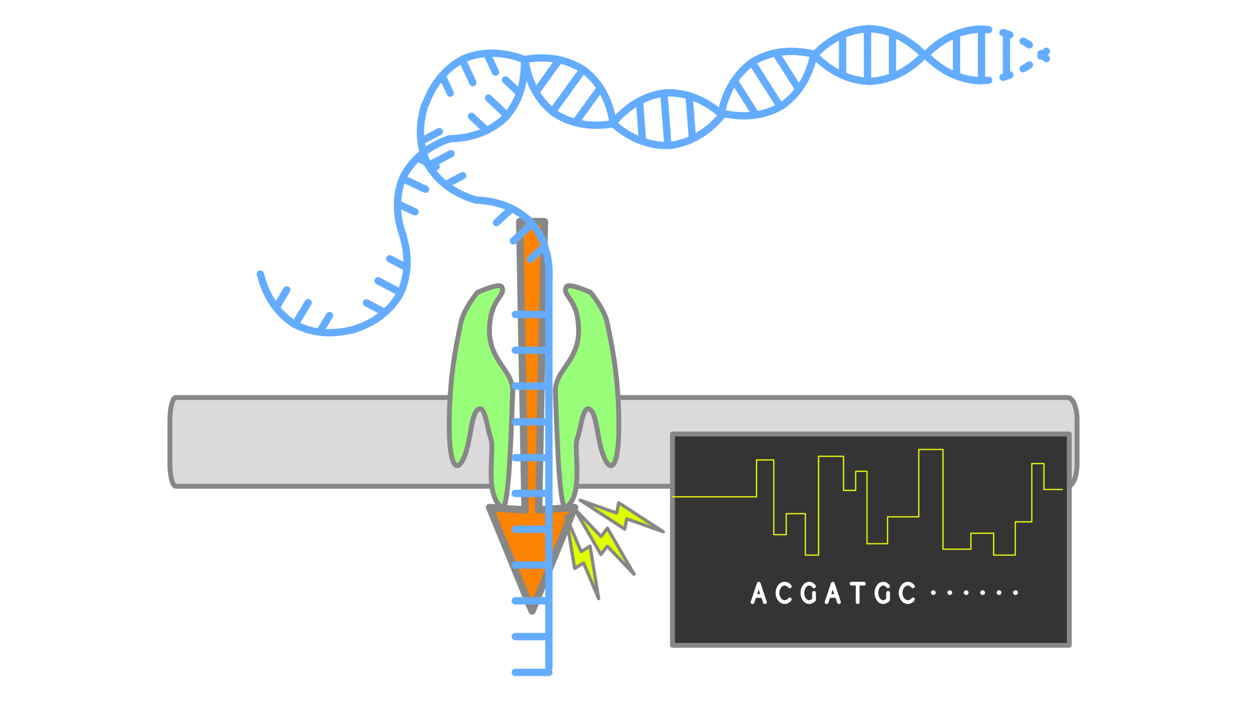
Aim 3: Sequence-function mapping
High error rate ~10%

Slide 17
Aim 3: Sequence-function mapping
92% sequence identity
Sequence alignments using pairwise2 in biopython
MinION read has 92% sequence identity with PcCas12a_block8 compared to <80% with all other parents
Notes:
Sequencing alignments using pairwise2 to ID blocks of protein coding blocks
Works in spite of errors
Have a comparator

Slide 18
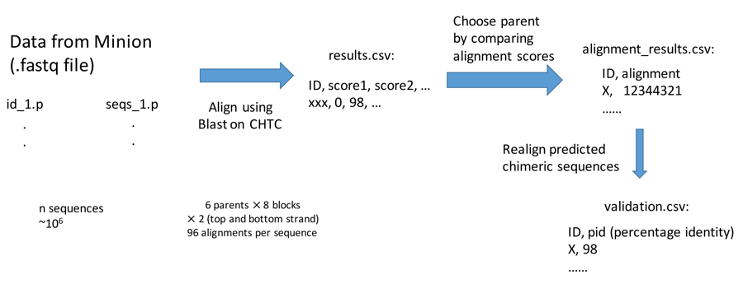
Aim 3: Sequence-function mapping
Sequence alignments
HTCondor
Haiyang Zheng (Ocean)
Notes:
MinION workflow identified 260,000 combinations

Slide 19
Aim 3: Sequence-function mapping
 | Unsorted (counts) | Sorted (counts)
Sort replicate 1 | 1,699,697 | 1,373,371
Sort replicate 2 | 1,763,761 | 1,870,868
Sort Replicate 3 | 1,237,235 | 1,445,443
Notes:
Right side is after processing through CHTC

Slide 20
Aim 4: Enrichment analysis of the blocks
s_{ij} corresponds to the counts found in the sorted sequences
u_{ij} corresponds to the counts found in the unsorted sequences
i refers to the parent number
j refers to the block number
T refers to total count for all parents at that block number
Notes:
Log enrichment scores and frequency changes
Equation with variables with bullet points

Slide 21
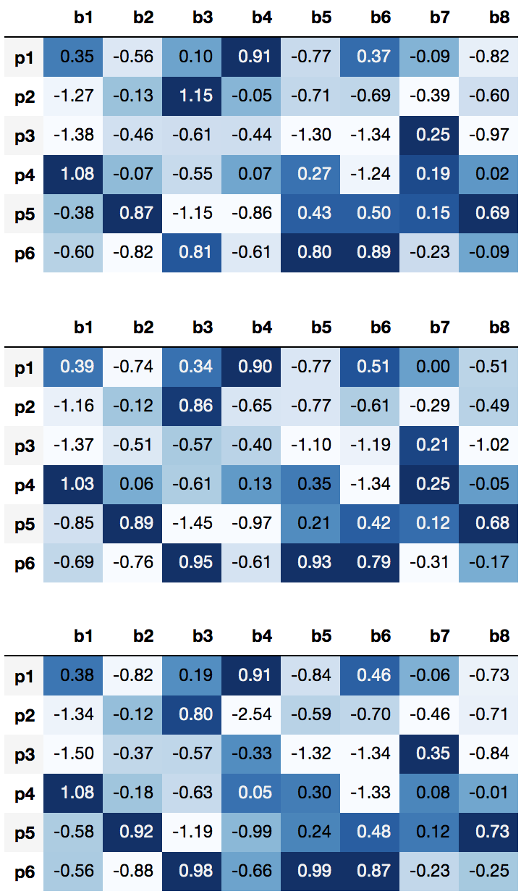
Aim 4: Enrichment analysis of the blocks
Sorting replicate 1
b1
b2
b3
b4
b5
b6
b7
b8
p1: Acidaminococcus sp. BV3L6 (AsCas12a)
p2: Moraxella bovoculli (MbCas12a)
p3: Lachnospiraceae bacterium ND2006 (LbCas12a)
p4: Francisella tularensis subsp. novicida (FnCas12a)
p5: Lachnospiraceae bacterium COE1 (Lb6Cas12a)
p6: Porphyromonas crevioricanis (PcCas12a)
Sorting replicate 2
Sorting replicate 3
Notes:
Log enrichment scores reproducible
45616635

Slide 22
Aim 4: Enrichment analysis of the blocks
Sorting replicate 1
b1
b2
b3
b4
b5
b6
b7
b8
p1: Acidaminococcus sp. BV3L6 (AsCas12a)
p2: Moraxella bovoculli (MbCas12a)
p3: Lachnospiraceae bacterium ND2006 (LbCas12a)
p4: Francisella tularensis subsp. novicida (FnCas12a)
p5: Lachnospiraceae bacterium COE1 (Lb6Cas12a)
p6: Porphyromonas crevioricanis (PcCas12a)
Sorting replicate 2
Sorting replicate 3
Notes:
Log enrichment scores reproducible
45616635

Slide 23
Aim 4: Enrichment analysis of the blocks
1
b1
b2
b3
b4
b5
b6
b7
b8
Sorting replicate 1
2
3
4
5
5
6
6
p1: Acidaminococcus sp. BV3L6 (AsCas12a)
p2: Moraxella bovoculli (MbCas12a)
p3: Lachnospiraceae bacterium ND2006 (LbCas12a)
p4: Francisella tularensis subsp. novicida (FnCas12a)
p5: Lachnospiraceae bacterium COE1 (Lb6Cas12a)
p6: Porphyromonas crevioricanis (PcCas12a)
1
Sorting replicate 2
4
4
5
5
6
6
6
1
Consensus sequence: 45616635
AsCas12a and PAM Interacting (PI) domain
Sorting replicate 3
3
4
5
5
6
6
6
Notes:
Log enrichment scores reproducible
45616635
FnCas12a and PAM interacting domain - high activity - requires shorter PAM TTN, compared to TTTN

Slide 24
Conclusions and future directions
Developed FACS based screening method
High throughput (10 kHz)
High sorting efficiency (>90%)
Testing of 10⁶ variants
Characterize high activity chimeras from screen
Cleavage activity
PAM specificity and off-target effects
Develop generalized model for Cas12a-PAM binding
Test different PAM sequences with library
Test different cell culture conditions

Slide 25
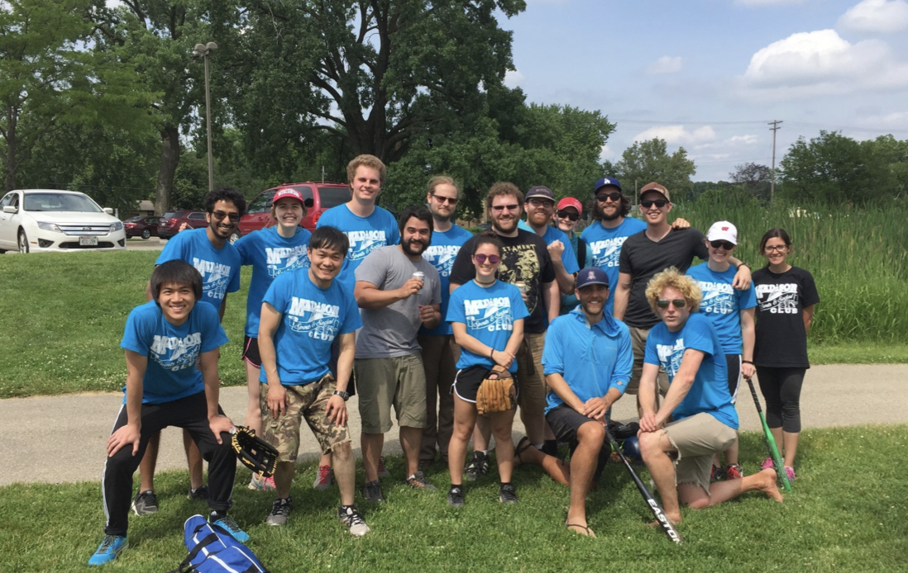
Acknowledgements
Prof. Philip Romero
Dr. Mark Politz
Dr. Aaron Lin
Dr. Job Grant
Haiyang Zheng (Ocean)
Jonathan Greenhalgh
Hridindu Roychowdhury
Zhiyuan Duan (Jerry)
Ben Bremer
Juan Diaz

Slide 26
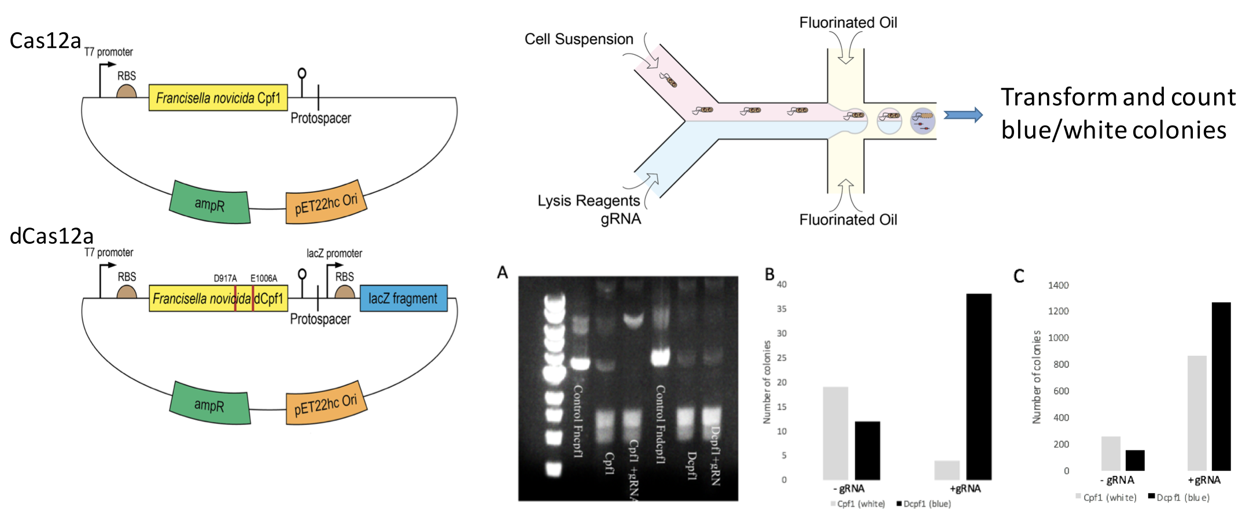
In-vitro screening with microfluidics
Notes:
Preliminary experiment

